Slide 1
V.Raja Swethaa Chennai EXL - 9744
Pet category Prediction
In this project , we aim to predict the pet category based on it’s dependent variables and to identify the hidden insights and patterns of the data that helps in effective prediction.

Slide 2
Problem Statement
Our goal is to develop a machine learning model that can predict the dog breed , differing in condition, color, length, height, issue date, etc. By analyzing various features and factors, we try to predict the category with high accuracy.

Slide 3
Flow of the project
Tasks | Details
Data Collection | Gather relevant details on the pets that differs in each factor,
Data Pre-Processsing | Impute the missing values , dtype conversion and process the data easier for data analysis.
Class Imbalance | Address any class imbalance issues in the dataset to ensure fair and accurate model training.
Base Models | Evaluate the performance of various ML models to establish a baseline.
EDA | Discover key insights through Exploratory Data Analysis (EDA) techniques.
Feature Selection | Select the most relevant features for the final model to enhance performance and interpretability.
Models After Feature Selection | Finalize and evaluate models after feature selection to maximize predictive power.
Cross - Validation | Validate the models using cross-validation techniques to assess generalization performance.
Conclusion | Summarize the findings and implications of the project

Slide 4
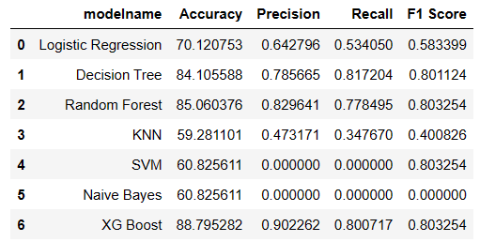
Base Model dataframe

Slide 5
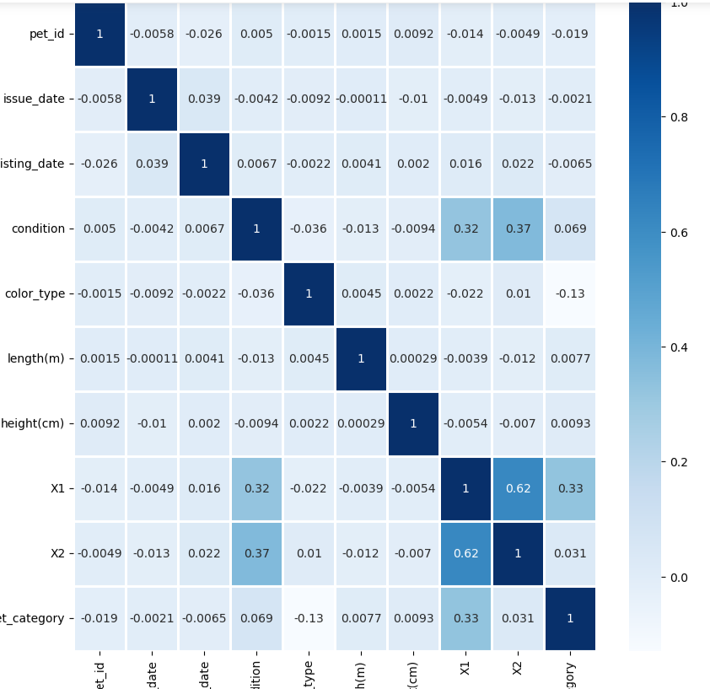
Correlation between columns

Slide 6
Exploratory Data Analysis (EDA)
Outlier Treatment:
Outliers are values within a dataset that vary greatly from the others—they're either much larger, or significantly smaller. Outliers may indicate variabilities in a measurement, experimental errors.
Skewness Treatment:
High skewness means a distribution curve has a shorter tail on one end a distribution curve and a long tail on the other. The data set follows a normal distribution curve; however, higher skewed data means the data is not evenly distributed.

Slide 7
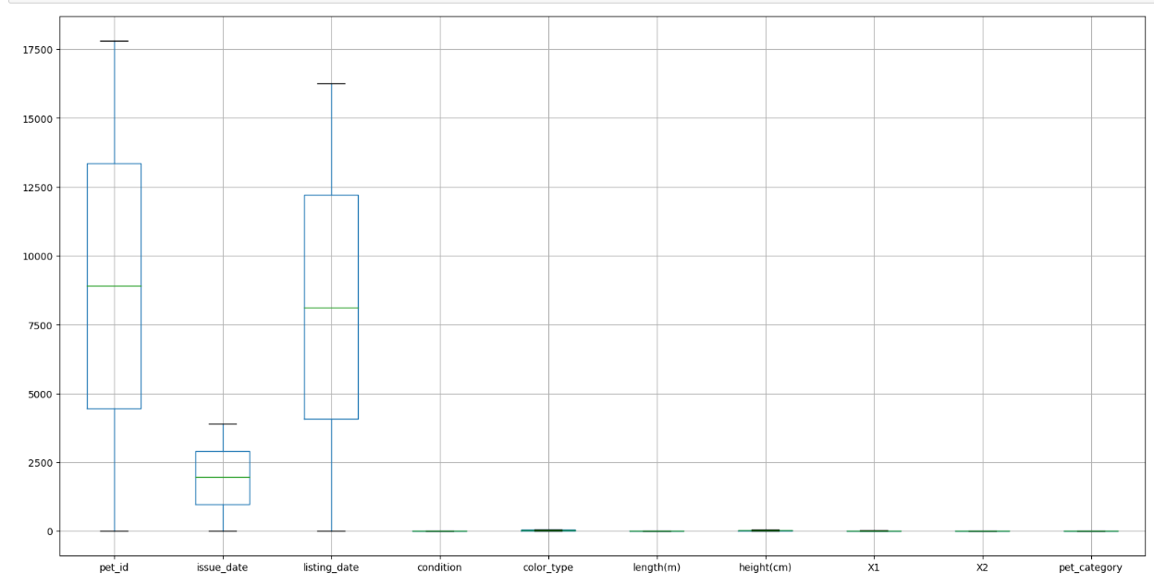
Outliers
There’s no outliers in the dataset as represented in the above boxplot.

Slide 8
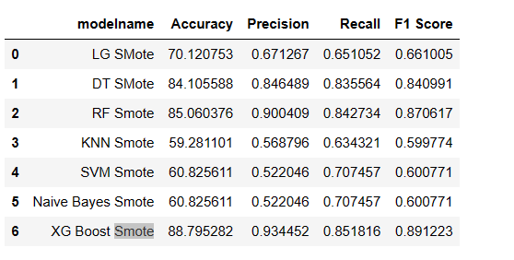
Class Imbalance (Over- Sampling: Smote)

Slide 9
Feature Selection
Feature selection is a important step in machine learning to improve model performance. It involves identifying the most relevant features from the dataset and eliminating irrelevant ones. By selecting the right set of features, we can enhance model accuracy and efficiency.
In the project RFE :Recursive Feature Elimination method is used for feature selection.

Slide 10
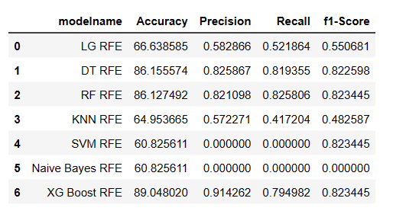
Models after Feature Selection

Slide 11
Final Conclusion
In the base ML models, XG boost gives higher accuracy compared with other models.
There’s only same difference in accuracy after applying smote over-sampling technique in which again XG Boost acts as better model.
Even after Feature selection method there’s no huge difference in the accuracy.
Finally , XG Boost acts as a better model in accuracy and performance.

Slide 12
Cross - Validation
Cross validation is a technique used in machine learning to assess the performance of a model on unseen data.
The k-fold method is a popular approach in cross validation, where the dataset is divided into k subsets or folds.
The model is trained on k-1 folds and tested on the remaining fold, repeating the process k times. This helps to get a more reliable estimate of the model's performance.

Slide 13
Drawbacks
Data Quality: The accuracy of a machine learning model is heavily dependent on the quality of the data it is trained on. If the data is noisy, incomplete, or biased, the model's predictions may be unreliable.
Hidden Patterns: Machine learning models may not perform well on data that has seasonal patterns or trends.
Non-measurable factors: Some factors that affect the outcome of a prediction may not be measurable or quantifiable, making it difficult for a machine learning model to accurately predict the outcome.

Slide 14
Thank you!!!

